Slide 1
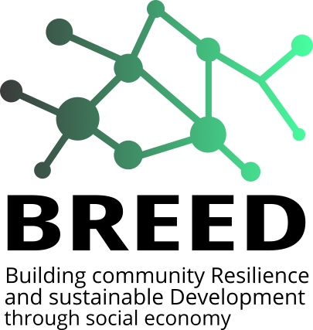


Funded by the European Union. Views and opinions expressed are however those of the author(s) only and do not necessarily reflect those of the European Union or European Commission. Neither the European Union nor European Commission can be held responsible for them.
BREED
Building community Resilience and sustainable
Development through social economy
Grant Agreement
Project 101074094 — BREED
The project aims to increase the capacity and resilience of local communities to foster social change and sustainable development through social economy as well as strengthen the capacity and resilience of local public administration, social organizations and civil society to boost innovative community development models based on social economy.

Slide 2



Funded by the European Union. Views and opinions expressed are however those of the author(s) only and do not necessarily reflect those of the European Union or European Commission. Neither the European Union nor European Commission can be held responsible for them.
FOLLOW US!
www.siteweb.eu
LOGO

